Slide 1
English 10 Honors Books

Slide 2
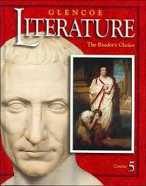
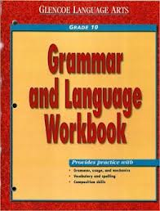
Textbooks

Slide 3
Additional Reading
Dracula by Bram Stoker (1st quarter)
Rebecca by Daphne du Maurier (2nd quarter)
Julius Caesar in textbook (3rd quarter)

